Slide 1
ANN
Dr. Rashmi Mahajan

Slide 2

ANN Concept
ROBOT

Slide 3
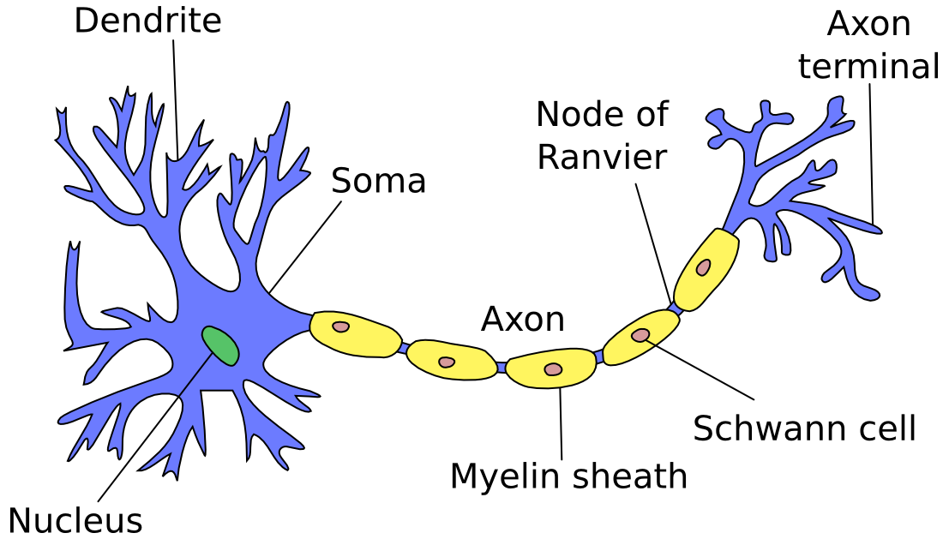

Slide 4
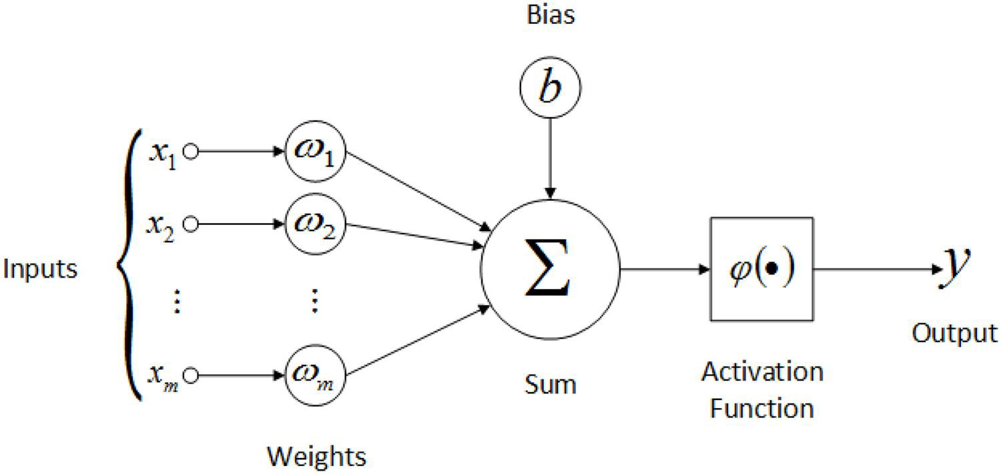

Perceptron- Single Stage

Slide 5
ANN
● An Artificial Neural Network is specified by:
Neuron Model: The processing unit of the ANN which performs a linear combination of inputs.
Architecture: Just like the set of neurons in brain. The neurons are connected by links which have weight.
Learning Algorithm: Modifies the weight of links to model a specific task. The training relies heavily on the data fed to the neurons.

Slide 6
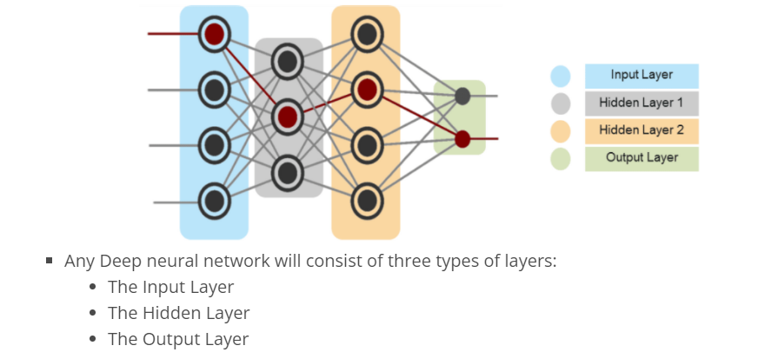
Multi layer

Slide 7
Multi layer perceptron
• Developed by Frank Rosenblatt in 1950-1960 inspired by McCulloh and Pitts.
The initial models were able to classify linearly separable functions but failed to so in case of a non-linear decision boundary.
Multi-layer perceptron – found as a “solution” to represent nonlinearly separable functions – 1950s.
The perceptron algorithm couldn’t converge when there were multiple local optima.
Throughout the 1950s it was believed that there exists no algorithm for multi-layer perceptron.
Perceptron convergence theorem Rosenblatt 1962: Perceptron will learn to classify any linearly separable set of inputs. Perceptrons and Neural Networks, Manuela Veloso

Slide 8
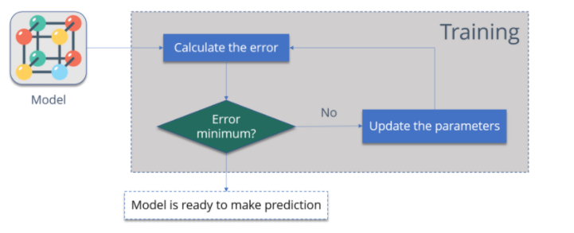
Back Propagation
Backpropagation is a supervised learning algorithm, for training Multi-layer Perceptrons (Artificial Neural Networks).

Slide 9
Calculate the – How far is your model output from the actual output.
Minimum Error – Check whether the error is minimized or not.
Update the parameters – If the error is huge then, update the parameters (weights and biases). After that again check the error. Repeat the process until the error becomes minimum.
Model is ready to make a prediction – Once the error becomes minimum, you can feed some inputs to your model and it will produce the output.

Slide 10
Back propagation
The Backpropagation algorithm looks for the minimum value of the error function in weight space using a technique called the delta rule or gradient descent. The weights that minimize the error function is then considered to be a solution to the learning problem.
Let’s understand how it works with an example:
You have a dataset, which has labels.
Consider the below table:

Slide 11
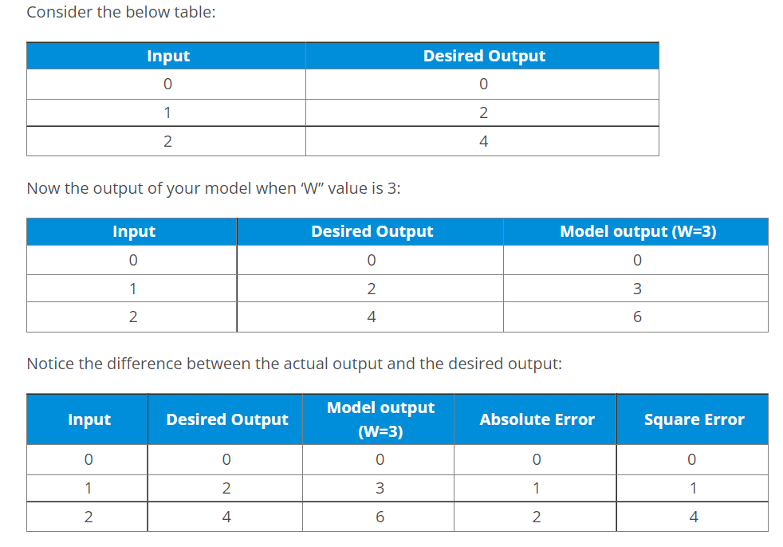









Slide 12
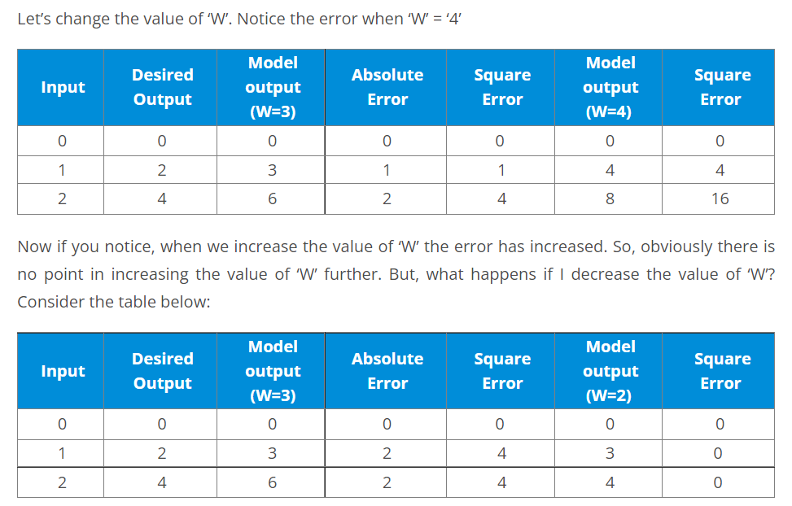






Slide 13
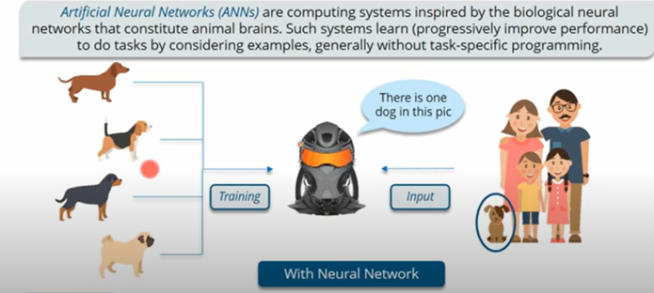
ANN Advantages
Picture

Slide 14
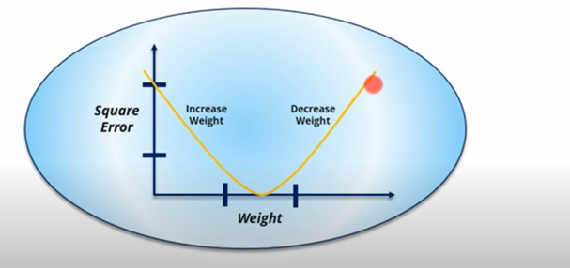
Error Function
Increase or decrease

Slide 15
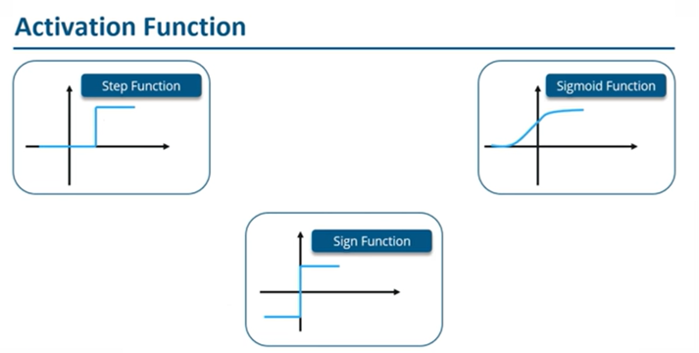
Activation function

Slide 16
Activation Function
ANNs use activation functions (AFs) to perform complex computations in the hidden layers and then transfer the result to the output layer. The primary purpose of AFs is to introduce non-linear properties in the neural network.
They convert the linear input signals of a node into non-linear output signals to facilitate the learning of high order polynomials that go beyond one degree for deep networks.
A unique aspect of AFs is that they are differentiable – this helps them function during the backpropagation of the neural networks.

Slide 17
Activation Function
If activation functions are not applied, the output signal would be a linear function, which is a polynomial of one degree.
While it is easy to solve linear equations, they have a limited complexity quotient and hence, have less power to learn complex functional mappings from data.
Thus, without AFs, a neural network would be a linear regression model with limited abilities.

Slide 18
Activation Function
This is certainly not what we want from a neural network. The task of neural networks is to compute highly complicated calculations. Furthermore, without AFs, neural networks cannot learn and model other complicated data, including images, speech, videos, audio, etc.
AFs help neural networks to make sense of complicated, high dimensional, and non-linear Big Data sets that have an intricate architecture – they contain multiple hidden layers in between the input and output layer.

Slide 19
Activation Function
In an ANN, the sigmoid function is a non-linear AF used primarily in feedforward neural networks. It is a differentiable real function, defined for real input values, and containing positive derivatives everywhere with a specific degree of smoothness. The sigmoid function appears in the output layer of the deep learning models and is used for predicting probability-based outputs. The sigmoid function is represented as:

Slide 20
Vanishing gradient
The reason exploding gradients occur is similar to that of vanishing gradients.
The gradient associated with each weight in the network is equal to a product of many numbers. If this is a product of values greater than one it may cause the gradients to become extremely large.
In contrast to the vanishing gradients problem, exploding gradients occur as a result of the weights in the network and not the activation function.

Slide 21
Vanishing gradient
The weights in the lower layers are more likely to be affected by exploding gradients as their associated gradients are products of more values. This may cause the gradients of the lower layers to become unstable leading to the algorithm diverging.

Slide 22
Exploding gradient
How Can The Exploding Gradient Problem Be Prevented?
Gradient clipping may be employed in order to address the exploding gradients problem.
Gradient clipping does not allow gradients to surpass a specified threshold value. This prevents gradients from becoming overly large while still allowing the updates to occur in the correct direction.
A full description of gradient clipping and how it is implemented is available here.

Slide 23
cnn
What Are Convolutional Neural Networks?
Convolutional Neural Networks, like neural networks, are made up of neurons with learnable weights and biases.
Each neuron receives several inputs, takes a weighted sum over them, pass it through an activation function and responds with an output.
The whole network has a loss function and all the tips and tricks that we developed for neural networks still apply on Convolutional Neural Networks

Slide 24
cnn
Neural networks, as its name suggests, is a machine learning technique which is modeled after the brain structure. It comprises of a network of learning units called neurons.
These neurons learn how to convert input signals (e.g. picture of a cat) into corresponding output signals (e.g. the label “cat”), forming the basis of automated recognition.

Slide 25
cnn
There are four layered concepts we should understand in Convolutional Neural Networks:
Convolution,
ReLu,
Pooling and
Full Connectedness (Fully Connected Layer).

Slide 26
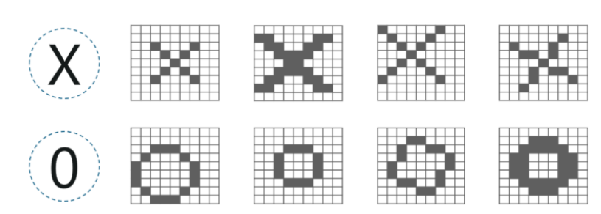
cnn

Slide 27
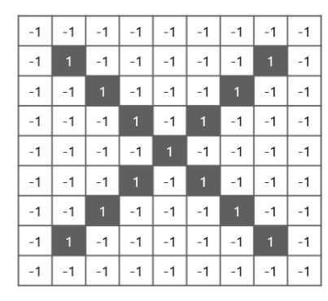
cnn

Slide 28
CNN stages
Convolution,
ReLu,
Pooling and
Full Connectedness (Fully Connected Layer).
We have 4 steps for convolution:
Line up the feature and the image
Multiply each image pixel by corresponding feature pixel
Add the values and find the sum
Divide the sum by the total number of pixels in the feature

Slide 29
CNN stages
Convolution,
ReLu,
Pooling and
Full Connectedness (Fully Connected Layer).
ReLU Layer
ReLU is an activation function. But, what is an activation function?
Rectified Linear Unit (ReLU) transform function only activates a node if the input is above a certain quantity, while the input is below zero, the output is zero, but when the input rises above a certain threshold, it has a linear relationship with the dependent variable.

Slide 30
CNN stages
Convolution,
ReLu,
Pooling and
Full Connectedness (Fully Connected Layer).
Pooling Layer
In this layer we shrink the image stack into a smaller size. Pooling is done after passing through the activation layer. We do this by implementing the following 4 steps:
Pick a window size (usually 2 or 3)
Pick a stride (usually 2)
Walk your window across your filtered images
From each window, take the maximum value

Slide 31
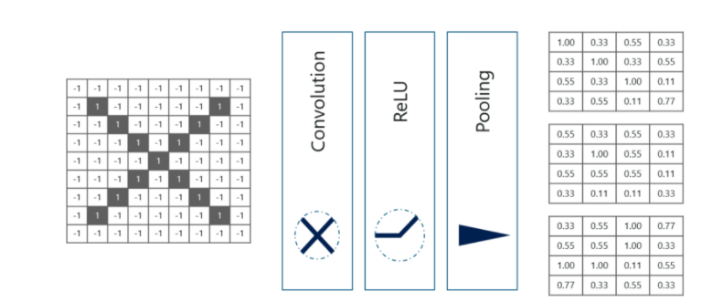
cnn
Stacking Up The Layers
So to get the time-frame in one picture we’re here with a 4×4 matrix from a 7×7 matrix after passing the input through 3 layers – Convolution, ReLU and Pooling as shown below:

Slide 32
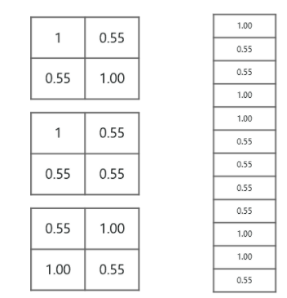
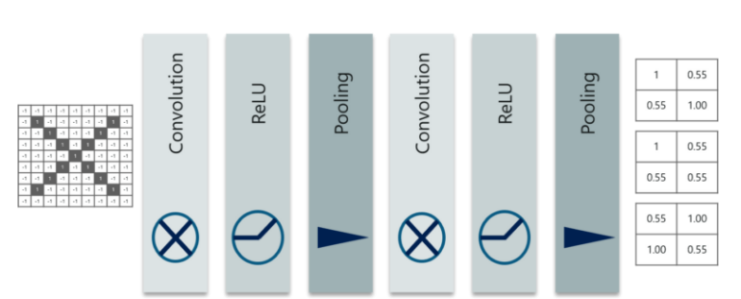
cnn
The last layers in the network are fully connected, meaning that neurons of preceding layers are connected to every neuron in subsequent layers.

Slide 33
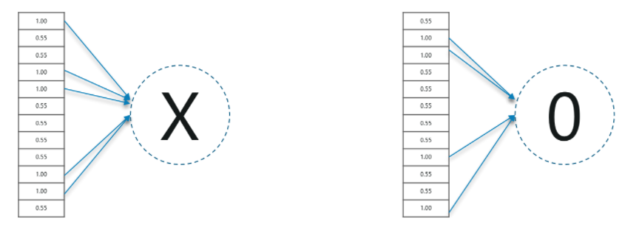
cnn

Slide 34
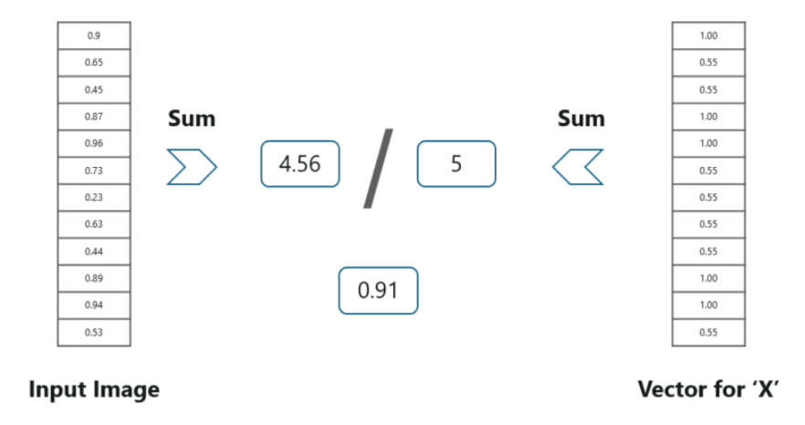
cnn

Slide 35
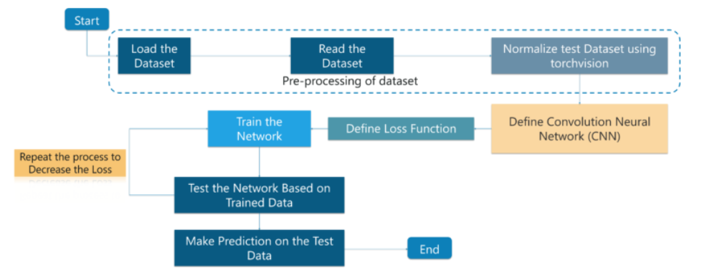
cnn

Slide 36
cnn
Convolutional Neural Networks is a popular deep learning technique for current visual recognition tasks.
Like all deep learning techniques, Convolutional Neural Networks are very dependent on the size and quality of the training data.

Slide 37
Striding
Striding
Basically a computer read an image from left to right and from top to bottom. Therefore it starts from the top-left corner all the way to bottom-right corner.

Slide 38
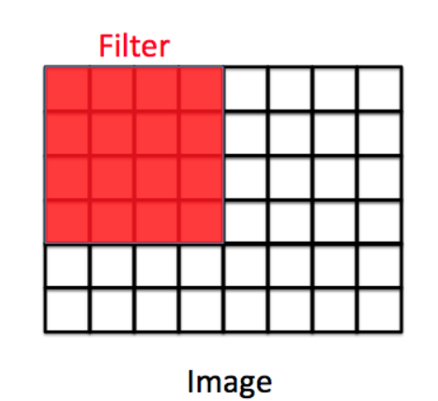
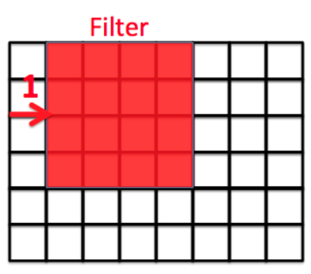
striding
Then we define how far the filter moves from one position to the next position by “stride”.

Slide 39
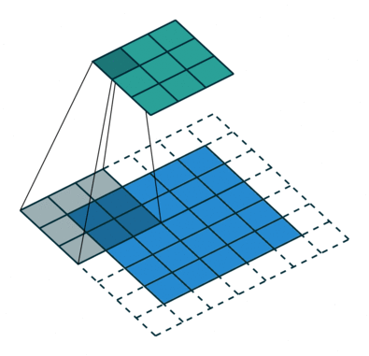
Dilation-pooling

Slide 40
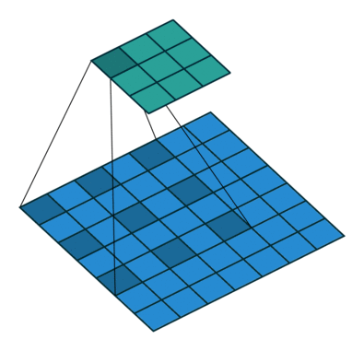

Slide 41
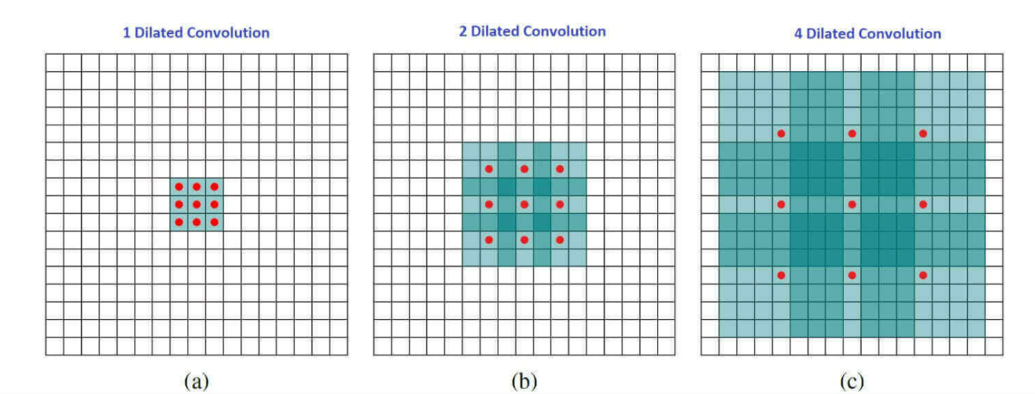

Slide 42
The red dots represent that the image we get after convolution is with 3 x 3 pixels. We see that the output of all three dilated convolutions have equal dimensions but the receptive field observed by the model is entirely different. Receptive field simply tells us how far the red dot can "see through". It is 3 x 3 when l=1, 5 x 5 when l=2, and 7 x 7 when l=3. The increase in receptive field means that we are able to observe more without any additional costs!

